Slide 1
side effects takes away the ability to completely control the outcome of the execution

Slide 2

Reactive Streams Specification

Slide 3

Stav Alfi https://github.com/stavalfi/lectures

Slide 4

Notes:
Everything

Slide 5

Notes:
Step back:
Stateless, Immutable, Pure function and Side effects
Functional Interfaces Family
Declarative pipelines
Native solutions for declarative & Async code in Java
Reactive Streams - Introduction
Project Reactor - Introduction
Spring Reactive Web - Introduction

Slide 6
Function<T,U>
Supplier<T>
Predicate<T>
Consumer<T>
Notes:
Immutable object
Stateless method
Side effects
Pure function
Side effects & Pure functions advantages
Declarative pipelines
Native solutions for declarative & Async code in Java

Slide 7
Function<T,U>
Supplier<T>
Predicate<T>
Consumer<T>
Notes:
Immutable object
Stateless method
Side effects
Pure function
Side effects & Pure functions advantages
Declarative pipelines
Native solutions for declarative & Async code in Java

Slide 8
Function<T,U>
Supplier<T>
Predicate<T>
Consumer<T>
Notes:
Immutable object
Stateless method
Side effects
Pure function
Side effects & Pure functions advantages
Declarative pipelines
Native solutions for declarative & Async code in Java

Slide 9
Function<T,U>
Supplier<T>
Predicate<T>
Consumer<T>
Notes:
Immutable object
Stateless method
Side effects
Pure function
Side effects & Pure functions advantages
Declarative pipelines
Native solutions for declarative & Async code in Java

Slide 10
Function<T,U>
Supplier<T>
Predicate<T>
Consumer<T>
Notes:
Immutable object
Stateless method
Side effects
Pure function
Side effects & Pure functions advantages
Declarative pipelines
Native solutions for declarative & Async code in Java

Slide 11
Integer f1: … f2() …
String f2: … f3() …
Char f3: … throws …
Notes:
Now they all have side effects

Slide 12
Integer f1: … f2() …
String f2: … f3() …
Char f3: … throws …
Notes:
Now they all have side effects

Slide 13


Slide 14
Integer f1 (throws Exception): … f2() …
String f2 (throws Exception): … f3() …
Char f3 (throws Exception): … throws …
Notes:
Now they all have side effects

Slide 15
Integer f1 (throws Exception): … f2() …
String f2 (throws Exception): … f3() …
Char f3 (throws Exception): … throws …
Notes:
Why its bad:
(1) Tests:
Separate tests
If not - extremely harder and time-consuming!
(2) Readability
(3) Expansion

Slide 16
Solutions?

Slide 17
pipeline:
char c = f3()
String str = f2()
try: Integer num = f1()
Catch: do something else…

Slide 18
pipeline:
char c = f3()
String str = f2()
try: Integer num = f1()
Catch: do something else…
Notes:
Disadvantage:
1. f4 must handle the error or it will have side effects.
* When I have side effects – I can’t control over what will be the outcome of the execution of my functions -> I can’t divide the work -> less concurrency.

Slide 19
pipeline:
Stream.of(f1,f2,f3)
.forEach(function-> function.run())

Slide 20
pipeline:
Optional.of(f3.run())
.map(result_f3 -> f2.run(result_f3))
.ifPresent(result_f2 -> f1.run(result_f2))

Slide 21
pipeline:
Optional.of(f3.run())
.map(result_f3 -> f2.run(result_f3))
.ifPresent(result_f2 -> f1.run(result_f2))

Slide 22
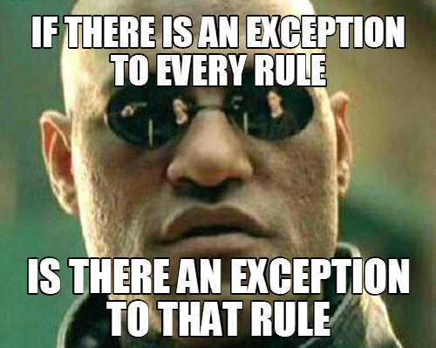

Slide 23
FAIL!
Checked exceptions needs
special attention

Slide 24

Should we be single threaded?

Slide 25
Blocking vs Synchronous

Slide 26

Invoking and waiting

Slide 27
Non-Blocking operation?
Notes:
Invoking a method & Asking if it can complete now.

Slide 28
Async operation?
Notes:
Never block my thread. (may start only when my function ended and it doesn’t have to do nothing more - with the same thread).

Slide 29
 | Synchronous | Async
0...1 | Future Optional | CompletableFuture
0…Infinity | Java Streams
Notes:
Never block my thread. (may start only when my function ended and it doesn’t have to do nothing more - with the same thread).

Slide 30
FAIL!
Checked exceptions needs
special attention

Slide 31
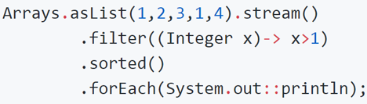

Slide 32
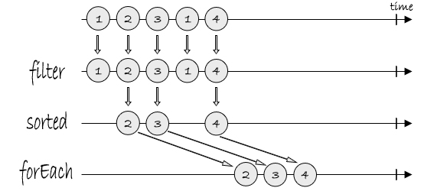
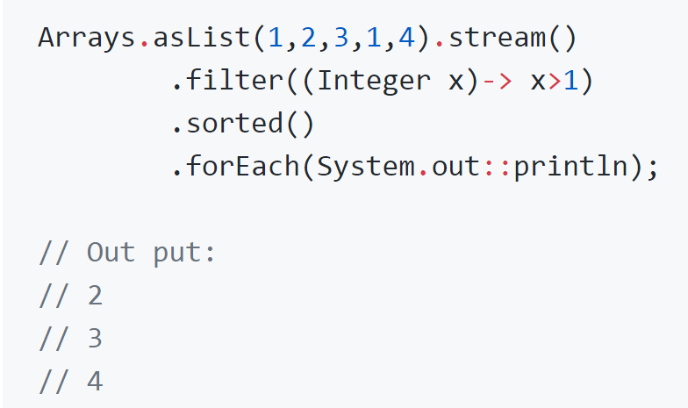

Slide 33
Java streams are pull based

Slide 34


Slide 35
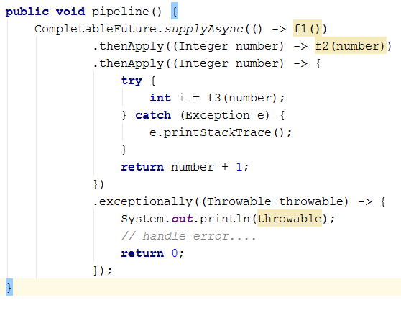
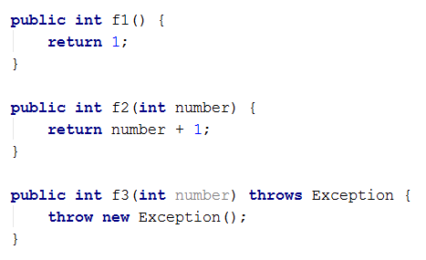
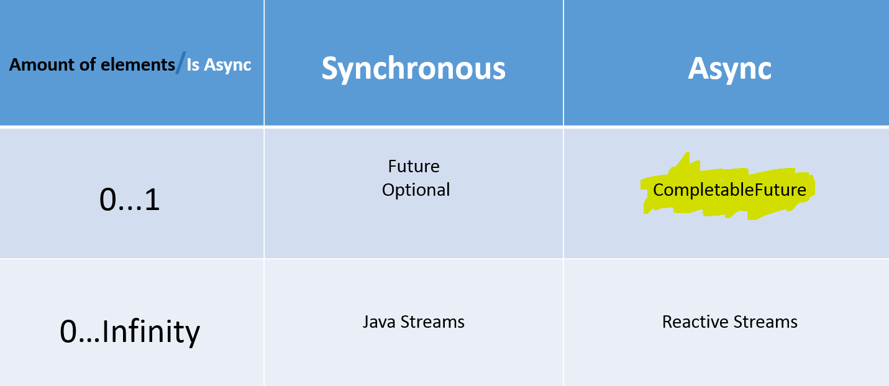
Native solutions – CompletableFuture error handling

Slide 36
Native solutions – CompletableFuture conclusion
Handles only unchecked exceptions
Handles only 0…1 elements in the streams
How can I handle [0…Infinite] amount of elements asynchronously?

Slide 37
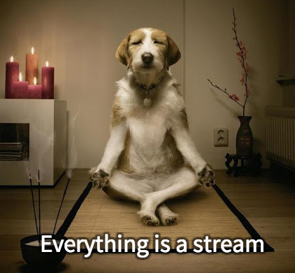
Reactive Streams - Introduction
But first, 5 min break ☺

Slide 38
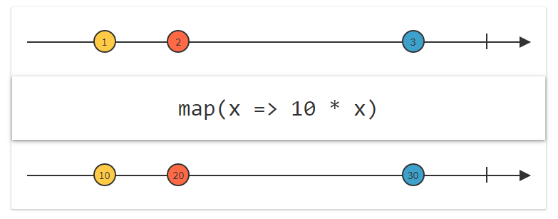
Reactive Streams - Marble diagrams

Slide 39
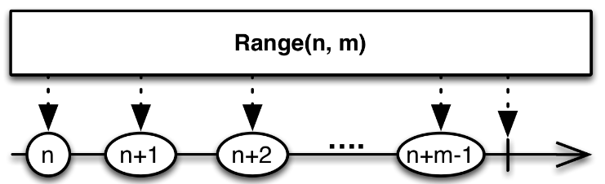
Reactive Streams - Marble diagrams

Slide 40
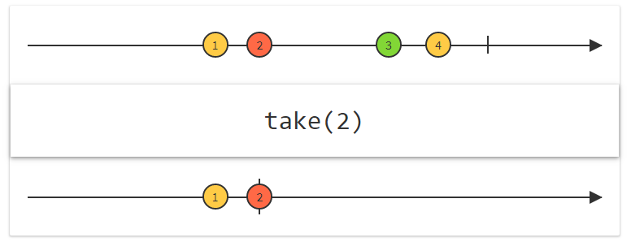
Reactive Streams - Marble diagrams

Slide 41
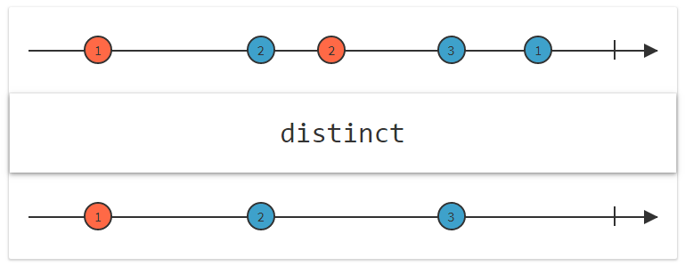
Reactive Streams - Marble diagrams

Slide 42
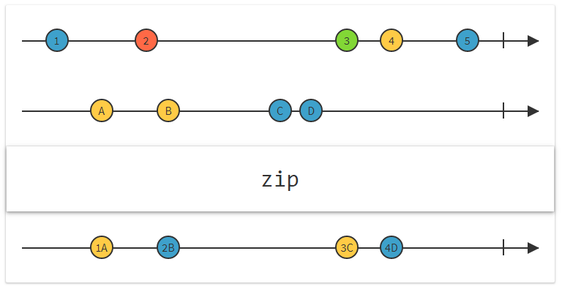
Reactive Streams - Marble diagrams

Slide 43
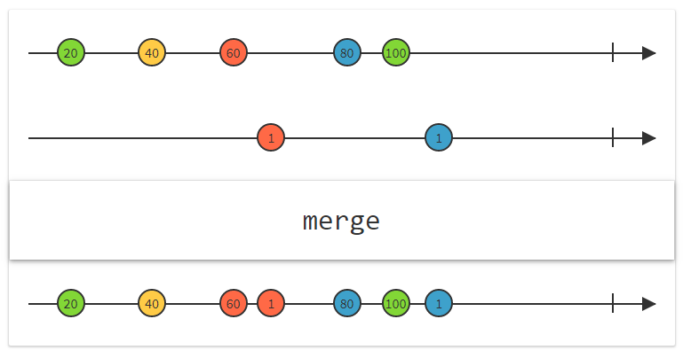
Reactive Streams - Marble diagrams

Slide 44
http://rxmarbles.com/#buffer
http://rxmarbles.com/#repeat
http://rxmarbles.com/#distinctUntilChange

Slide 45
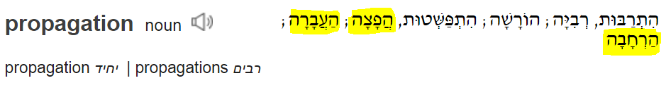
Reactive programming– What is it?
Reactive programming is a declarative programming paradigm concerned with data streams and the propagation of change. Reactive programs maintain a continuous interaction with their environment, but at a speed which is determined by the environment

Slide 46
Reactive Streams– What is it?
Reactive Streams is an initiative to provide a standard for asynchronous stream processing with non-blocking back pressure.
In short, it is a standard (Java 9) set of rules to write reactive programming code for the JVM and JavaScript.

Slide 47
Reactive Streams – API
Publisher - sends [0…Infinite] elements to everyone who want.
Subscriber - Ask for [0…Infinite] elements from a publisher.
Subscription - Used by the subscriber for requesting [N] elements or cancel the stream.
Processor - Is a Subscriber and a publisher == He get and send [0…Infinite] elements.

Slide 48
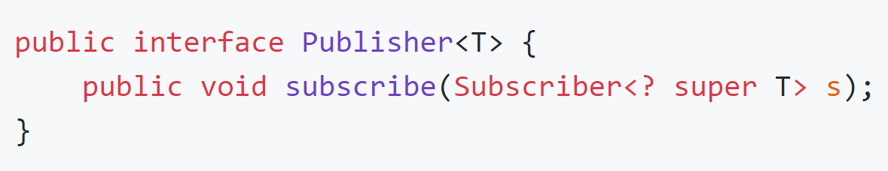
Reactive Streams - Publisher

Slide 49
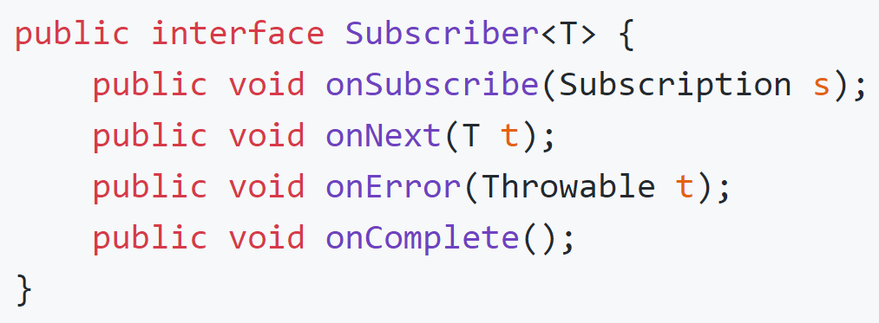
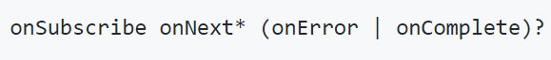
Reactive Streams - Subscriber

Slide 50
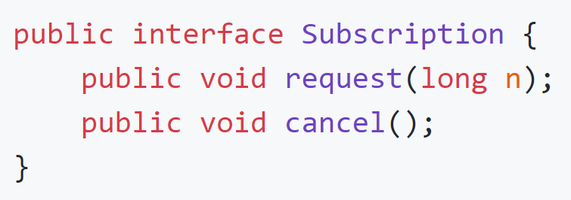
Reactive Streams - Subscription

Slide 51
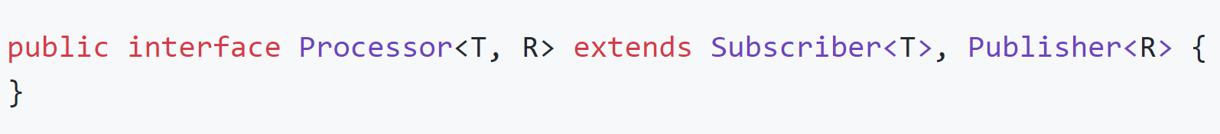
Reactive Streams - Processor

Slide 52
Reactive Streams Specification
http://www.reactive-streams.org/
https://github.com/reactive-streams/reactive-streams-jvm/blob/v1.0.2/README.md
http://reactivex.io/

Slide 53
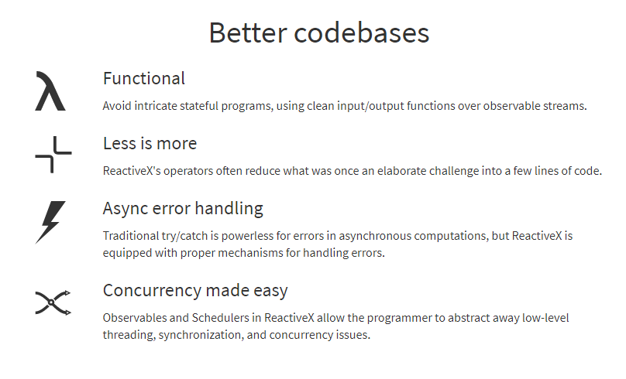
Project Reactor - Introduction
But first, 5 min break ☺

Slide 54

Project Reactor - Introduction
Reactor is a fully non-blocking reactive programming foundation for the JVM, which supports backpressure.
It implements the Reactive Streams specification.

Slide 55
Project Reactor - Introduction
Amount of elements/Is Async | Synchronous | Async
0...1 | Mono<T> | Mono<T>
0…Infinity | Flux<T> | Flux<T>
Session 5

Slide 56
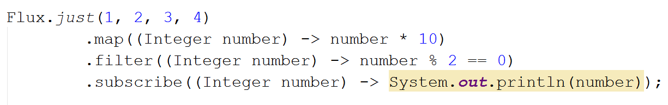
Project Reactor - Code
Publisher - sends elements
Subscriber - Ask for elements
Subscription - Used by the subscriber for requesting [N] elements or cancel the stream.
Processor – Subscriber + Publisher

Slide 57
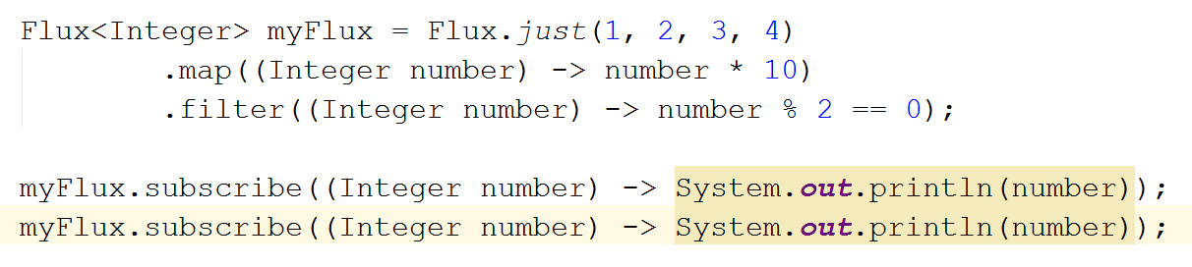
Project Reactor - Code
Publisher - sends elements
Subscriber - Ask for elements
Subscription - Used by the subscriber for requesting [N] elements or cancel the stream.
Processor – Subscriber + Publisher
Streams are by default cold & blocking

Slide 58
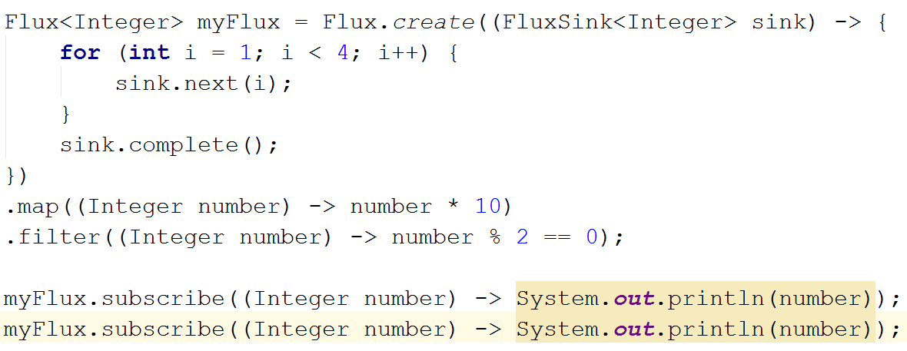
Project Reactor - Code
Streams are by default cold & blocking

Slide 59
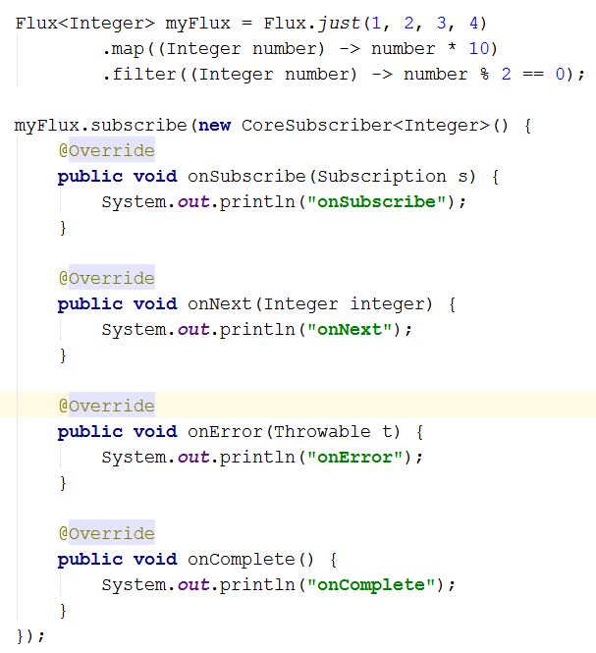
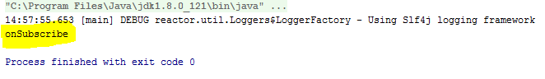
Project Reactor - Code
Streams are by default cold & blocking

Slide 60
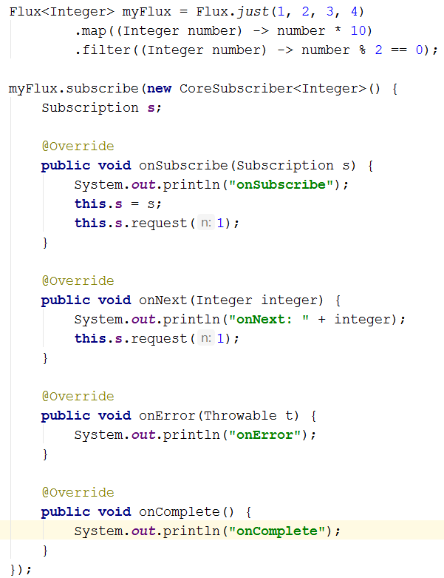
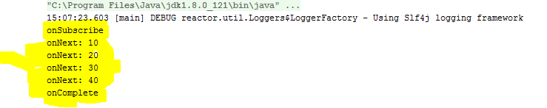
Project Reactor - Code
Streams are by default cold & blocking

Slide 61
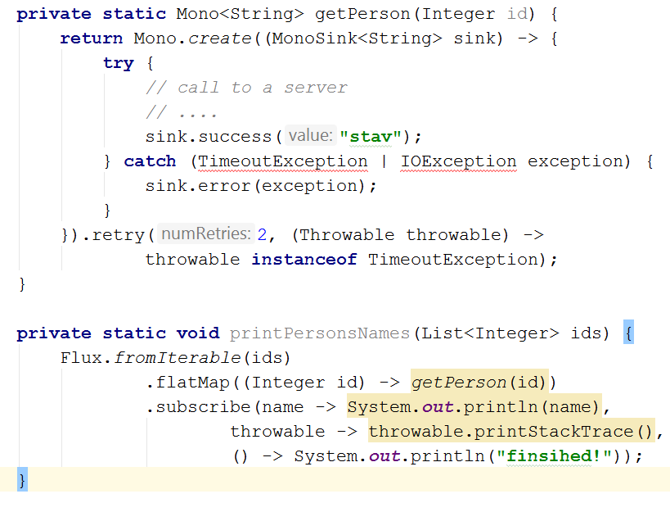
Project Reactor - Code
Streams are by default cold & blocking

Slide 62

Project Reactor – What have we seen
Async
Sync
Cold Streams

Slide 63
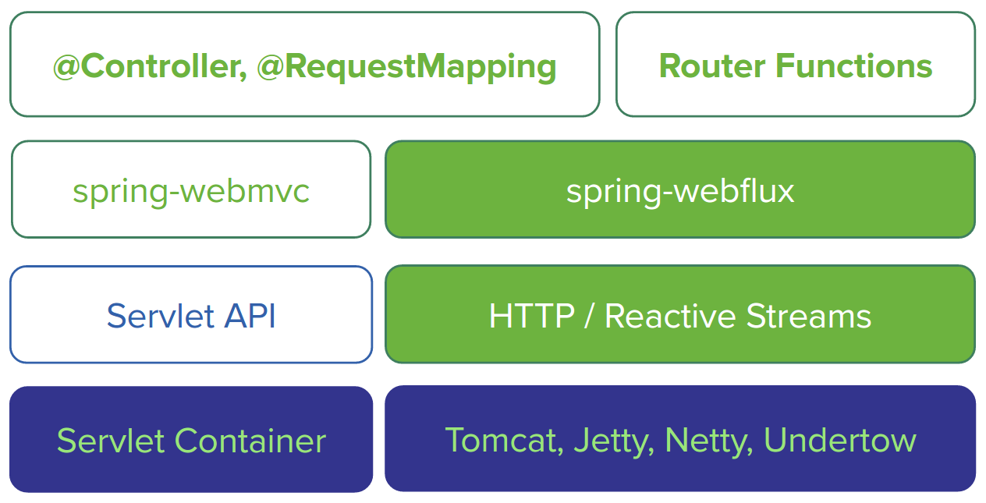
Spring Reactive Web - Introduction
But first, 5 min break ☺

Slide 64
Spring Reactive Web - Introduction
The greater the latency per call, or the interdependency among calls, the more dramatic the benefits.

